Slide 1
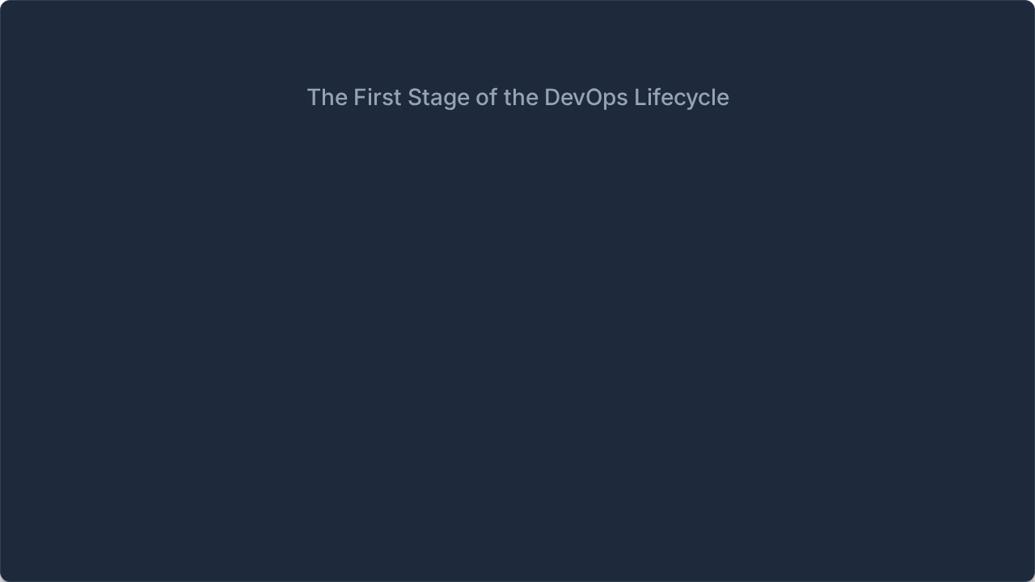


Planning in DevOps
Planning is the starting point of the DevOps lifecycle where requirements, user stories, sprint backlog and the definition of done are prepared.
Presented by: Your Name
Subject: DevOps | Topic: Planning / Plan Stage

Slide 2







What is DevOps?
DevOps is a culture and set of practices that brings together Development (Dev) and IT Operations (Ops) to deliver software faster, more frequently, and more reliably through collaboration and automation.
Three Important Pillars
1. People / Culture
2. Process
3. Tools
Shared ownership, "You build it, you run it", and a culture of no blame between teams.
Focuses on small changes, frequent releases, and continuous feedback loops.
Automation of building, testing, deployment, and monitoring systems.

Slide 3

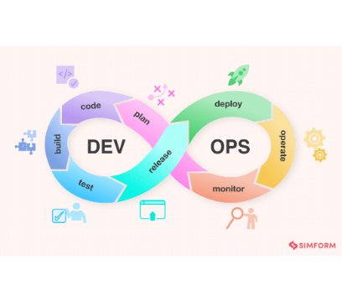

The DevOps Lifecycle
The DevOps lifecycle is an infinity loop (∞) because the process is continuous. It consists of eight stages.
Stage | Main Activity | Tools
Plan | Requirements, backlog, DoD | Jira, Trello
Code | Write & version code | Git, GitHub
Build | Compile & package | Maven, Jenkins
Test | Automated testing | JUnit, Selenium
Release | Prepare artifact | GitLab CI
Deploy | Push to target env | Docker, Ansible

Slide 4

What is Planning in DevOps?
The Plan stage is the first stage of the DevOps lifecycle. The purpose is to decide what needs to be developed and what the expected result should be before development starts.
Key Components of Planning
Simple Flow
•
Requirements: What needs to be built.
Planning follows a structured progression to turn ideas into actionable developer tasks.
•
User Stories: Features from a user's perspective.
•
Sprint Backlog: Work selected for the current iteration.
•
Definition of Done: Conditions for completion.
↓
↓
↓
↓

Slide 5


Requirements in Planning
Requirements describe what the software or feature needs to achieve. During planning, the team identifies exactly what needs to be built.
Planning Starts With:
Example: Student Portal
Understanding core requirements
Requirement:
"Students should be able to view their attendance."
Identifying expected functionality
This high-level requirement is then broken down for execution:
Breaking requirements into smaller pieces
Organizing work for development
Defining what successful completion means

Slide 6


User Stories
What is a User Story?
Structure
A user story describes a feature from the user's point of view. It helps the development team understand:
As a [user]
I want [feature]
So that [reason/benefit]
•
Who needs the feature?
•
What do they need?
•
Why do they need it?
Why they are useful:
Example
"As a student, I want to view my attendance so that I can know my attendance percentage."
•
Easy to understand and focus on user needs
•
Can be broken into development tasks
•
Help the team prioritize work

Slide 7

Sprint Backlog
A sprint backlog contains the work selected for a particular sprint. It converts planned requirements and user stories into specific, actionable work that the team can execute.
Project: Student Portal
User Story | Development Task
View attendance | Create attendance API
View attendance | Create database table
View attendance | Create frontend page
View attendance | Add authentication
View attendance | Test attendance feature
Agile practices like sprints, stand-ups, backlogs, and retrospectives work closely with DevOps planning.

Slide 8



Definition of Done (DoD)
The Definition of Done (DoD) specifies the conditions that must be satisfied before a task or user story can be considered complete.
Example — Attendance Feature
The feature is considered "Done" when:
"Code written" ≠ "Work completed"
Code is completed
Code is reviewed by a peer
The planned Definition of Done gives the team a clear, shared completion standard, ensuring quality before moving to the next stage.
Automated tests pass
Required security checks pass
Feature works as expected
Documentation is updated

Slide 9

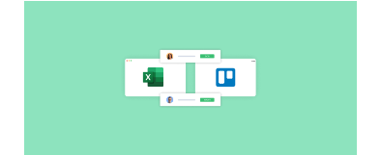






Tools Used for Planning
Jira
Used for Requirements, User stories, Sprint planning, and Backlog management.
Azure Boards
Used for Work tracking, Backlogs, Planning, and Managing development tasks.
↓
Trello
Used for Organizing tasks, Tracking work, and Visualizing workflow via Kanban.
↓
↓

Slide 10






Planning is a Continuous Process
One of the most important concepts is that the DevOps lifecycle is an infinity loop. Planning does not end after development starts. Work does not simply finish and stop.
Continuous Improvement Cycle Example
→
→
→
→
App Deployed
Slow Perf.
Monitor Detects
New Req/Story
Dev Restarts

Slide 11



Agile and DevOps Planning
Agile and DevOps are closely related. DevOps extends Agile practices into delivery and operations.
"Agile helps the team develop the right software quickly, while DevOps helps deliver and operate that software reliably."
Agile | DevOps
Focuses mainly on development | Focuses on complete delivery and operations
Uses sprints | Uses CI/CD and automation
Uses backlog | Uses backlog + delivery pipeline
Customer/product feedback | Customer + production monitoring
Sprint-sized releases | Very small and frequent releases

Slide 12

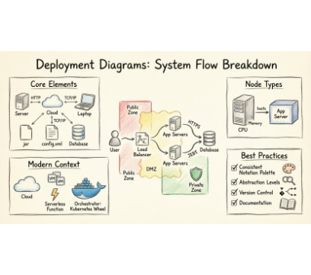

Infrastructure Planning with IaC
Planning in DevOps also involves planning infrastructure. Infrastructure as Code (IaC) means defining infrastructure (servers, networks, databases) using machine-readable configuration files instead of manual setup.
Main Advantages:
•
Repeatable
•
Scalable
•
Version controlled
•
Self-documenting
•
Fast
•
Reduces config drift
Key Tools
Terraform: Infrastructure provisioning (e.g., using terraform plan to preview changes before applying).
Ansible: Configuration management.

Slide 13













Complete Planning Workflow
↓
↓
↓
↓
↓
↓
↓
↓
↓
↓
↓
The crucial DevOps concept: Monitoring and production feedback return to planning, creating a continuous loop.

Slide 14


Conclusion
The Starting Point
Planning is the foundation of the DevOps lifecycle. It helps the team understand, prioritize, organize, and eventually develop and monitor software effectively.
"In DevOps, planning is not a one-time activity; it is a continuous cycle of learning, delivering and improving."
Focus Areas
•
Requirements & User Stories
•
Sprint Backlog
•
Definition of Done
•
Utilizing tools like Jira, Azure Boards

Slide 15



Image Sources
https://www.manageengine.com/products/service-desk/images/devops-lifecycle-diagram.png
Source: www.manageengine.com
https://unito.io/wp-content/uploads/2022/08/Group-1087616.png
Source: unito.io
https://maplewoodu.edulink.cc/wp-content/uploads/2026/04/deployment-diagrams-hand-drawn-infographic.jpg
Source: maplewoodu.edulink.cc

